Slide 1
Software Engineering
COMP2225
Session 1: An Introduction to Software Engineering
Dr. Adrian Als & Dr. Paul Walcott
Department of Computer Science, Mathematics and Physics
University of the West Indies, Cave Hill Campus
Barbados
NEXT

Slide 2
Session Objectives
After completing this session you will be able to:
  Define software engineering
  Describe why software is important
  Describe a few software myths
  Describe the concept of a process model
  Discuss the qualities of good software

Slide 3
Session Objectives
After completing this session you will be able to:
  Discuss the following software creation issues: reusability, portability and interoperability
  Compare and contrast software engineering roles

Slide 4
What is engineering?
“Engineering is the analysis, design, construction, verification and management of technical (or social) entities.”

Slide 5
What is software engineering?
Software Engineering is the application of a systematic, disciplined, quantifiable approach to the development, operation, and maintenance of software; that is, the application of engineering to software. It is also the study of the approaches used.

Slide 6
What is computer science?
The systematic study of computing systems and computation. The body of knowledge resulting from this discipline contains theories for understanding computing systems and methods; design methodology, algorithm and tools; methods of testing of concepts; methods of analysis and verification; and knowledge representation and implementation.
www.nitrd.gov/pubs/bluebooks/1995/section.5.html

Slide 7
What is computer software?
Computer software is the product that software engineers design and build. It includes the executable programs, documentation (both electronic and hard copy) and data associated with a program – this may take the form of numbers and text, or even pictorial and multimedia formats.

Slide 8
Why do software engineering?
There are several reasons why you might want to do software engineering:
It is an opportunity to gain exposure in the dynamic field of software engineering. The knowledge and skills gained will be a definite asset to anyone continuing in the field of software development, whether in commercial or research environments.

Slide 9
Why do software engineering cont’d?
It will widen your understanding of computer science and leave the possibility of future postgraduate studies in the field open.
It is a compulsory course for your degree and will give you four credits.

Slide 10
Activity
Write a short paragraph explaining why you decided to take this course.

Slide 11
Why is software important?
Computer software is a tool that drives business decision making. It serves as the basis for modern scientific investigation and engineering problem solving.

Slide 12
Why is software important cont’d?
It is a key factor that differentiates modern products and services. It is embedded in systems of all kinds including: transportation, medical, telecommunications, military, industrial process, entertainment and office products.
Notes:
Transportation:Employed in cars where the driver(s) preferences may be automatically configured at the touch of a button. These preferences include seat and rear view mirror positions, climate control settings and even favourite radio stations. In addition, the use of sensors allows for impact detection warning mechanisms and the driverless car. Another good example is the autopilot feature employed in the aircrafts.
Medical:Used in performing task such as magnetic resonance imaging (MRIs) and ultrasound test. Another example is the analysis of the signals (e.g. EEP, ECG… ) obtained from test equipment to provide information to the attending physicians.
Telecommunication:3G Technology now allows things such as picture messaging and some mobile phone operators are even providing sports highlights using this feature.
Military:In radar systems, and ‘smart’ bomb technology
Industrial process:In controlling the machines used for mass assembly of products, e.g. automobiles.
Entertainment:There is a large gaming market on platforms such as Atari, Playstations, XBox and personal computers. In addition, software is also present in musical instruments such as keyboards, synthesisers and rhythm machines.
Office Products:A common example is the photocopier. At the top end of the market these products can scan, sort and assemble (staple) and perform limited self-maintenance functions.
As seen from the examples above, the scope of the field is diverse as it effectively combines engineering and software programming disciplines with project management. Thus a good software engineer should be competent in all three of these areas.

Slide 13
Why is software important cont’d?
Software is virtually inescapable in the modern world. It is the driver for new advances in everything from elementary education to genetic engineering.

Slide 14
Why has software engineering become a discipline?
In the early years of computing (some 50+ years ago) the software applications that were created were small and relatively easy to test. With an increase in the speed of computers came the demand for larger more powerful applications.
Notes:
Unreliable software examples include (IMB 360, dBASE IV v1.0
As with any entity carrying possible financial benefits, whether the profit generating or loss limiting, software production needed to be optimised. Typically, a team of software specialist (each focusing on one part of the technology to be delivered to the client) is employed to tackle the complexity issue. However as the scope is often large and intricate a structured approach is required and a standard must also be maintained so that, for example, in the event of any staffing changes, continuity would not be severely affected. The control, organisation and stability offered by a structured approach are crucial for the successful development a good software product.

Slide 15
Why has software engineering become a discipline?
Software project managers began developing software using informal approaches which led to software that was delivered late; was over budget; was unreliable and was difficult to maintain.

Slide 16
Why has software engineering become a discipline?
This ‘software crisis’ became the motivation for a radically different developmental approach that needed to be both reliable and cost-effective.

Slide 17
Why has software engineering become a discipline?
This approach needed to answer the following questions:
  Why does it take so long to get software finished?
  Why are the development costs so high?
  Why can’t we find all the errors before the software is released?
  Why is there difficulty in measuring progress as the software is being developed?

Slide 18
Activity
Discuss the paper “Software and Software Engineering” by F. L. Bauer as it relates to the software crisis. Also discuss the solutions proposed in the paper.

Slide 19
Software Engineering Roles
To understand software engineering roles the following definitions are required:
User - the person(s) who uses the software.
Software development - covers all aspects of software production before the product enters the maintenance phase, namely: requirements elicitation, authoring of specifications, design, implementation and testing

Slide 20
Software Engineering Roles Cont’d
These roles include: the client, marketing and sales, program manager, product manager, project manager, business analyst, quality assurance and the software engineer.
  The client is the individual or organisation for which the product is developed
  The marketing and sales team markets and sells the product

Slide 21
Software Engineering Roles Cont’d
  The program manager is responsible for coordinating interdependencies between projects in his/her portfolio. These projects might be for different software products
  The product manager is responsible for a given product in the program manager’s portfolio
  The project manager runs a given project

Slide 22
Software Engineering Roles Cont’d
  The business analyst is responsible for getting requirements from clients and creating the relevant documentation
  The quality assurance personnel ensure that the software is functioning correctly
  The software engineer is the individual or organisation responsible for the production of the software.

Slide 23
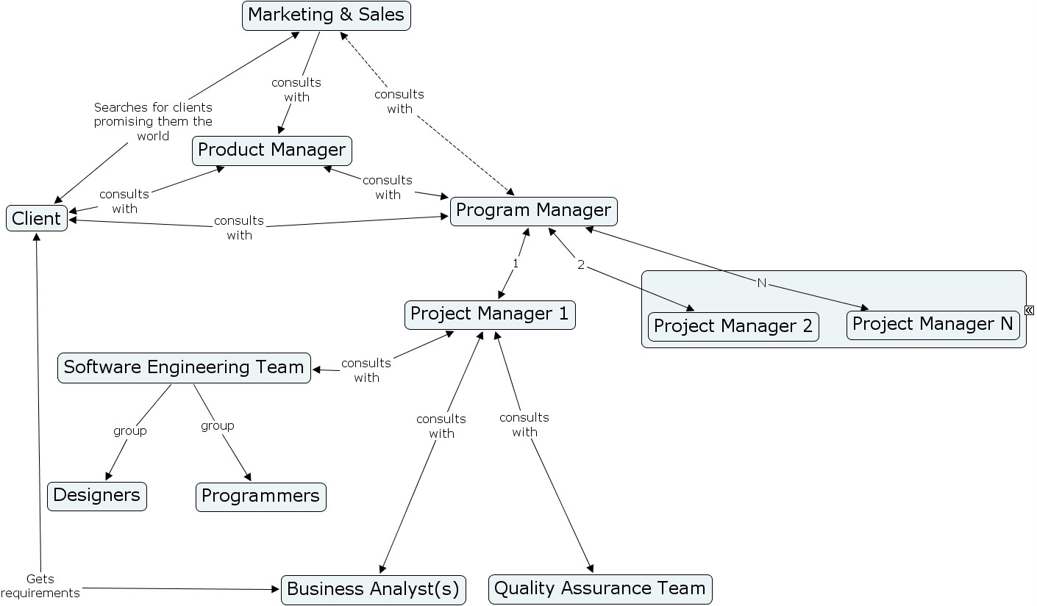
Role Relationship Diagram
Notes:
Product manager has critical expertise for generating business, he/she has to have strategic and tactical expertise:
Strategic expertise – responsible for positioning the product and assessing the competition
Tactical expertise – responsible for developing promotional campaigns, communicating with marketing and sales representatives to ascertain customer needs.
Business Analyst ideally should have a MBA
Program Manager is essentially an engineer of sorts or a technologist

Slide 24
Product Development Scenario
Mr. Heel is the owner of Dog Muzzles Inc. which specialises in the manufacture of fashionable plastic shoes. He has contracted a local software development firm to build a product that meets the following specifications and constraints:
  Maintains a list of the stock
  Records the levels of the stock
  The product will be built and released by January 1, 2011

Slide 25
Product Development Scenario Cont’d
The product manager will consult with the program manager for an estimate of when it can be released and at what cost. This information could be determined upon consultation with the project manager(s)
Contracts and service level agreements must be agreed upon. These discussions will be between the client and sales & marketing.

Slide 26
Product Development Scenario Cont’d
The project manager assembles a team of:
  Business analysts
  Software engineers
  Software testers
  Documentalist

Slide 27
Product Development Scenario Cont’d
The business analysts determines the requirements from either the client or the product manager.
The software engineer implements the requirements into a working product which is tested by the software quality assurance team before it is delivered to the client.
Notes:
The business analysts determines the requirements from the client/product manager {former being better}

Slide 28
Product Development Scenario Cont’d
If a bug is detected in the software then the steps from requirements determination to implementation and testing must be repeated.
The documentalist produces user manuals, newsletters and release documentation.

Slide 29
Learning from Failures
A project manager and client agreed, via word of mouth, to complete an enhancement to an existing product.
Without procuring a signed contract he organised a project to complete the enhancement.

Slide 30
Learning from Failures Cont’d
Upon completion, the project manager returned to the client who then informed him that the enhancement was no longer required. Furthermore, he would not be paying for it.
As the project manager, would you have done anything differently?
Notes:
The customer did renege on the earlier “agreement” but who is to blame? (Him/Developer)
Do you believe that the developer has any legal recourse?
Could the client not say that the project manager misunderstood him since nothing was written down?
What does this teach about the importance of having a signed contract?

Slide 31
Learning from Failures Cont’d
More development work had to be done to reverse the enhancement made to the product.
This resulted in valuable development and testing time being lost that could have been invested elsewhere.
This translated into resource losses (e.g. money and time)

Slide 32
Software Engineers’ Role
The software engineer should have a global view of the production procedure. That is he should be aware of:
  1. The problem to be solved
  2. The complete objective of the final product
  3. The means by which the final product will be built and the tools required - strategy
  4. The design, testing and maintenance considerations
Notes:
The focus of this course will be on the software engineer and the process models and methodologies employed within software development. So lets first look at the role of the software engineer. Later we will look at the concepts of the software process (model) and software methodologies
In essence the software engineer should be aware of the entire software process.

Slide 33
Software Engineers’ Role Cont’d
In the software specification (definition) phase the goal of the software engineer is to determine
  what information is to be processed
  what functions and performances are desired
  what system behaviour can be expected
  what interfaces are to be established
  what design constraints exist
  what validation criteria are required
Notes:
In the software specification (definition) phase the goal of the software engineer is to determine what the requirements of the system are and to relate that into a set of specifications.
The functional performances are both functional and non-functional. [Have the students research these on their own]

Slide 34
Software Engineers’ Role Cont’d
In the software development and validation phases the software engineer attempts to determine:
  How the specifications are implemented in the programming language of choice
  How the interfaces will be characterised
  How will testing be performed

Slide 35
Software Engineers’ Role Cont’d
In the evolution (/support) phase the software engineer focuses on changes that are associated with:
  Error correction – usually (software bugs) reported by the client.
  Further development – based on meeting the clients evolving needs.

Slide 36
Software Engineers’ Role Cont’d
This includes changes due to say an operating system or hardware update
Enhancements to facilitate additional functionality as required by the client, and
Preventative maintenance (/software reengineering), which involves changes to the software so that it may be easily corrected, adapted and enhanced.

Slide 37
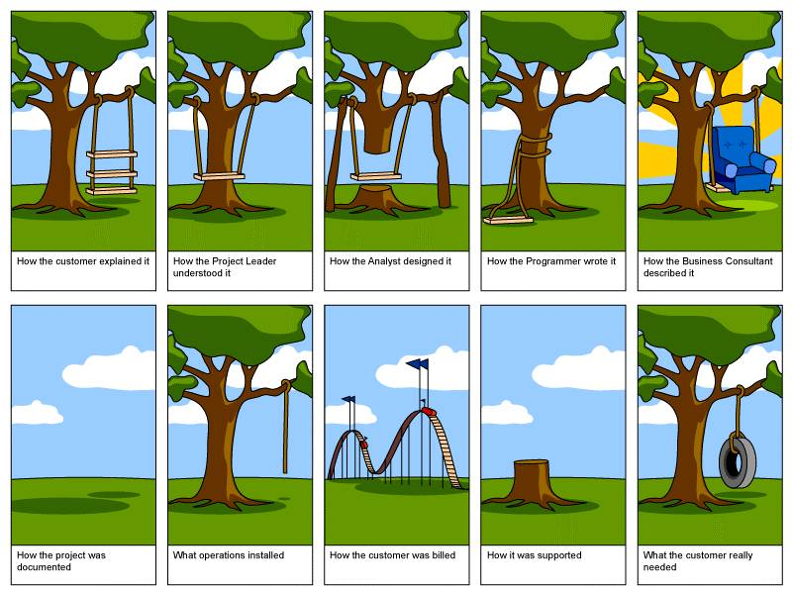

Slide 38
Logical Process Flow
Requirements
Specifications
Design
Implement & Integrate
Test
Maintain
Notes:
The process is geared towards developing “Good” software. Good here relates to quality.

Slide 39
Software Myths
Management Myth
If we get behind schedule, we can add more programmers and catch up.
Adding more programmers in an adhoc manner may actually retard productive development.
Customer Myth
A general statement of the objectives is enough to begin writing the program. The details can be filled in later.
Poor up front definition is a major cause
of failed software. A detailed description of the software is required before the coding begins.
Practitioner Myth
Once we write the program and get it to work, our job is done.
60-80% of all effort expended on software will be expended after it is delivered to the customer for the first time.

Slide 40
Software Myths
Recognition of these myths and their associated realities promotes a healthy appreciation for the structured software development process.

Slide 41
Qualities of Good Software
Maintainability
  Evolution of software to meet changing client needs.
Dependability
  Reliability, security, safety
Efficiency
  Memory utilisation, responsiveness, processing time
Usability
  User friendly, adequate documentation
Notes:
Non functional
Response time
Understandability (of source code)
User Friendly
Reliable
Maintainability: Allows software to remain useful.
Dependability: Dependable software should not cause any physical or economic damage in the event of a system failure.
Efficiency: Software should not waste system resources such as memory or processor cycles.
Usability: Software should be usable with out undue effort by the user for whom it was designed. Thus it must have an appropriate interface.

Slide 42
Software Creation Issues
Reusability
Portability
Interoperability

Slide 43
Reusability
The software industry is plagued with “re-inventing the wheel”
Why should the same old programs be rewritten over and over again
Prudent steps should be taken to minimise the likelihood of reinventing the wheel
Notes:
The software world is known for its tendency to reinvent the wheel over and over again. We wish to see how prudent steps can be taken to avoid such repetition of efforts.

Slide 44
What is Reuse?
Reuse refers to the ability to take components from one product to facilitate the development of a new product with different functionality
Reuse may cover program code, designs, test data, documentation or other elements from a previous project
Notes:
Ruse refers to more than just code. Other candidates for reuse include: Specifications document,Service level agreements, design templates, methodologies, frameworks etc….
Wrt code there is:
Function reuse – based on libraries (the benefit here is that these have been around for a long time, in come cases 40+ years)
Component reuse – ranging from subsystems to single objects.
Application reuse – Some texts indicated that the entire application can may be reused by incorporating it w\o change into other systems (COTS product reuse), or by developing application families to run on different platforms, or specialised to the needs of particular customers.
Benefits of Reuse: Increased reliability, reduced process risk, accelerated development, standards compliance (in house)
COTS – Commercial off the shelf.

Slide 45
What is accidental reuse?
Some reuse will occur accidentally
This occurs when a developer discovers that some previously written design/component can be used in the current product
It will save some time/effort for the current product, and
Is completely unplanned for
Notes:
Accidental reuse occurs when developers of a new product discover that their product can be augmented by the reuse of a component of a previously developed product. In the case reuse was not originally planned but occurred as an afterthought.

Slide 46
What is deliberate reuse?
It occurs when a previous component which was designed for reuse is used
Deliberate reuse requires forethought and planning, and
Can result in significant savings
Notes:
Deliberate reuse occurs when components that were specifically designed for future reuse are used.
The significant savings are realized during maintenance or on new projects/products. The savings may not necessarily occur during development as there is a cost involved in designing for reuse; particularly when it comes to rigorous testing.
Consider: Team A and Team B have to develop a product and the analysis of the requirements indicates that 100 classes are needed. Team A and B are the same size, have the same experience and skill level. However Team A has no library whereas Team B has a robust library with 55 of the 100 classes. What is the likely result?
Team B will 1) finish Sooner 2) have a lower development cost and 3) will produce a product that has fewer defects.

Slide 47
Ego is a reuse hurdle
Wrong headedness in an organisation may result in opportunities for reuse being neglected
A “we do it best here” mentality
Ineffective management may allow software professionals to believe that what they write from scratch is best
Notes:
Reuse hurdle #1: Ego Issues.
Ineffective management may allow software professionals to believe that only products written by them from scratch are the best. This is because the programmer would know all the intricate details of the object being reused. Using the coding example, they may also claim that they don’t know how the module would react with different data.
Biased Thinking
Stubborn thinking
Results in accidental reuse at best.

Slide 48
The issue of quality is a reuse hurdle
Uncertainty about potential faults in possible reusable components may discourage reuse
Past problems in earlier products may overshadow the desire to reuse those earlier components
Extensive testing before reusing components may ease concerns
Notes:
Reuse hurdle #2: Quality Issues.
Uncertainty about the number of faults in a potential reusable component may create an unwillingness to use software written by others. Extensive testing may ease these concerns.

Slide 49
Retrieval of components for reuse is a reuse hurdle
Candidate components for reuse must be stored and catalogued
Identification and retrieval of past components may be problematic, especially if they were used in older systems
Need to have some system in place to ease the burden of retrieval
Notes:
Reuse hurdle #3: Retrieval Issues.
If a large number of reusable components must be stored there may be need for some system to handle identification of components and their retrieval. Ease of retrieval will promote reuse of the component.

Slide 50
Expense is a reuse hurdle
Increased design costs – reusable component must be carefully designed
Increased costs associated with actually reusing a component
Costs of defining and implementing a reuse process
Notes:
Reuse hurdle #4: Expenses.
Costs are associated with (a) production of the reusable component in the first place due to increased design costs, (b) costs associated with actually reusing a component and (c) costs of defining and implementing a reuse process.

Slide 51
Legal issues are reuse hurdles
Reuse can be problematic if earlier client has exclusive rights to components
In some cases using components in the first product for another client may violate first client’s copyright
Notes:
Reuse hurdle #5: Legal Issues.
In the case where a piece of software is sold exclusively under contract to a client reusing components in this first product for another client may violate the first client’s copyright.
This is not such a problem when the developer and the client are from the same organisation (I.e. in house) or if the clients are from the same organisation.

Slide 52
What is Portability?
Refers to the ease with which the product can be moved from one compiler/operating system or particular hardware to another.
Goal is to minimise recoding product when moving from one type of environment to another
Notes:
Portability – Refers to the ease with which a product can be run on another compiler/hardware/operating system configuration without recoding from scratch

Slide 53
What are the benefits of Portability?
Recovery of development costs by selling versions to a wider market (that is gain market share on other platforms)
Ability to handle future hardware configurations and thereby extend the life of the product
Reduce re-training costs. A completely new product on another platform may require much more retraining

Slide 54
What are the potential barriers to portability?
Care must be taken when designing software products to avoid the following major incompatibilities –
  Hardware
  Operating System (OS)
  Numerical accuracies
  Compiler
Notes:
Each computer platform represent has a unique way of representing data (e.g. Macs and IBM compatibles)
System calls for one OS (Unix) will be different to say WinXP. Also if a piece of software is dependent on the resource management scheme used by one OS it may not work on another.
Java and ADA excepted, most HLLs do not have a standard predefined size for data types (ints, floats etc….) Integers may be 16 bits in one HLL and 32 bits in another. Serious faults may occur if this is ignored.
The use of not-so-popular languages may result in the inability to find compilers for target machines.

Slide 55
Hardware / Operating System Incompatibility
Reliance upon a particular hardware can stifle portability E.g. a Mac stores data differently to a PC, or a Sun Workstation has a different architecture to a VAX
Reliance upon certain OS dependent features such as system calls E.g. Some system calls under Unix may not be present for Windows XP and vice versa. Resource management schemes differ.
Notes:
· Hardware Incompatibilities. E.g. a Macintosh stores data in a different format to that of a PC. Different computer types have different ways of representing data.
· OS Incompatibilities. E.g. System calls for one OS (say Unix) will vary to that of another ( say Windows XP). Additionally if a piece of software is dependent upon the resource management schemes employed by one OS it may not work on another.

Slide 56
Numerical / Compiler Incompatibility
With the exception of Ada and Java many high level languages do not have predefined sizes for numeric values. E.g. An integer may be 16 bits or 32 bits
Methods of handling precision and round-off may vary.
Unpopular languages may not have compiler for target machine
There are always differences between features offered by compiler vendors
Presence of non-standard language features

Slide 57
Portability Enhancement Techniques
Use of standard features of high level programming languages
Isolate implementation dependent pieces of code so they can be easily identified and changed
Provide a layer of abstraction in software so that high level and low level routines are separated

Slide 58
Portability Enhancement Techniques Cont’d
Retention of detailed documentation so that parts of system that must be changed when porting are clearly identified
Use conversion utilities to port data E.g. convert to unstructured sequential files from old format then use another utility to convert to new format

Slide 59
What is Interoperability?
This is the level of mutual cooperation between object code from different vendors, written in different languages and running on different platforms
Relies on agreed standards by which objects are constructed
Allows products written by others to be used
Notes:
Interoperability – The ability of software and hardware on different machines from different vendors to share data.

Slide 60
What are some of the interoperability standards?
COM – Component Object Model. This is a complex standard developed by Microsoft
DCOM – Distributed COM
CORBA – Common Object Request Broker Architecture. This standard produced by international cooperation.
Web Services – provide reusable components via the Internet
Components which follow these standards will be interoperable.
Notes:
To achieve this goal a number of standards have been put forward. E.g. COM (Component Object Model), DCOM (Distributed COM) and CORBA(Common Object Request Broker Architecture). COM is a complex Microsoft initiative while CORBA is an internationally composed standard.
Example:
Company A’s C++ client running on a WinXP platform using company B’s Oracle database system running on Unix
E.g. Wabi on Unix allows MsOffice to run.

Slide 61
Use the Quiz for a Quick Recap
Do you want a quick recap? Why not use the quiz?
  Use either the immediate feedback version
    Provides a correct or incorrect message response after each question
  Or, the non-immediate feedback version

Slide 62
Software engineering is the application of engineering to software?
Software Engineering Quiz
Question 1
A
True
B
False
Peek
Click Peek to lookup the answer in the notes.
Skip

Slide 63
Which one of the following is not a good reason for doing software engineering?
Software Engineering Quiz
Question 2
A
The lecturer is cool
B
It prepares you for post graduate work
C
It is a requirement for a computer science degree
D
It exposes you to the correct method of building software systems
Skip

Slide 64
Software Engineering Quiz
Question 3
Software is virtually _____________ in the modern world.
Peek
Click Peek to lookup the answer in the notes.
Skip

Slide 65
Which of the following was not characterised by the software crisis?
Software Engineering Quiz
Question 4
A
Late delivery of software
B
Over-budget software
C
Unreliable software
D
Incompetent managers and software developers
Skip

Slide 66
Software development includes all aspects of software production up until the testing phase.
Software Engineering Quiz
Question 5
A
True
B
False
Peek
Click Peek to lookup the answer in the notes.
Skip

Slide 67
Program managers are responsible for coordinating interdependencies between projects for a single software product.
Software Engineering Quiz
Question 6
A
True
B
False
Peek
Click Peek to lookup the answer in the notes.
Skip

Slide 68
The program manager reports to the product manager.
Software Engineering Quiz
Question 7
A
True
B
False
Peek
Click Peek to lookup the answer in the notes.
Skip

Slide 69
A software engineer must know what testing is required for a given software project.
Software Engineering Quiz
Question 8
A
True
B
False
Peek
Click Peek to lookup the answer in the notes.
Skip

Slide 70
Once the software has been finished and delivered to the customer the software engineer’s job is completed.
Software Engineering Quiz
Question 9
A
True
B
False
Peek
Click Peek to lookup the answer in the notes.
Skip

Slide 71
Efficiency is a measure of the responsiveness of a piece of software.
Software Engineering Quiz
Question 10
A
True
B
False
Peek
Click Peek to lookup the answer in the notes.
Skip

Slide 72
The concept of reuse does not extend to the software design documents and user manuals.
Software Engineering Quiz
Question 11
A
True
B
False
Peek
Click Peek to lookup the answer in the notes.
Skip

Slide 73
Portability considers how easy it is to move a software product from one platform to another only.
Software Engineering Quiz
Question 12
A
True
B
False
Peek
Click Peek to lookup the answer in the notes.
Skip

Slide 74
Which one of the following is not an interoperability standard?
Software Engineering Quiz
Question 13
A
Cobra
B
Web services
C
COM
D
DCOM
Peek
Click Peek to lookup the answer in the notes.
Skip

Slide 75
Congratulations
You have successfully completed the quiz
Click here to see your report card

Slide 76
Reflective Question
With the increasing use of complex software in appliances, mobile devices and computers are we still in a “software crisis”?

Slide 77
Conclusions
In this session the reader:
  Defined software engineering
  Recognised why software engineering is important to this modern world
  Explored some software creation issues
  Exposed some of the myths associated with software engineering
  Discuss software engineering roles

Slide 78
References
Bauer, F. L. 1973. Software and Software Engineering. Society for Industrial and Applied Mathematics (SIAM) Review, 15 (2), pp. 469-480.
Sommerville, Ian. 2004. Software Engineering. 7th ed. USA: Addison Wesley
Pressman, R. S. 2005. Software Engineering: A Practitioner’s Approach. 6th ed. McGraw Hill

